Slide 1
From Notebooks to Apps: Scripting with Gooey
Peter Kucirek | WSP
April 9, 2019

Slide 2
Table of Contents
Gooey basics
Python scripting workflows with Gooey
Simple demonstration
Advanced demonstration – Mississauga Model Analysis Script
Questions / Discussions

Slide 3
The Basics
Gooey: Turns basic command-line-interface scripts into rudimentary desktop apps with minimal code.
Save time copy/pasting those pesky file and folder-paths without the boilerplate of kivy, tkinter, or QT
Project page & documentation: https://github.com/chriskiehl/Gooey
Install (Python 3.6+ works best) using pip:
pip install Gooey

Slide 4
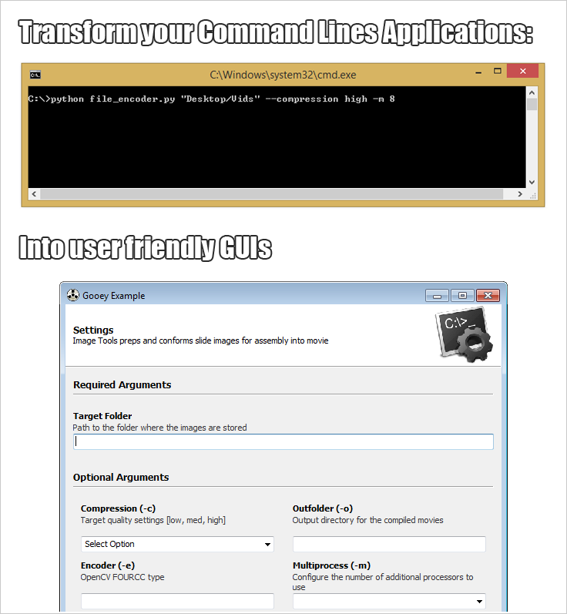
The Basics

Slide 5
The Basics

Slide 6
The Basics
from gooey import Gooey from argparse import ArgumentParser @Gooey def main(): parser = ArgumentParser(...) # rest of code if __name__ == '__main__': main()

Slide 7
Workflow
Easier to use
Full app
Gooey app
CLI Python Script
Jupyter Notebook
More effort to code

Slide 8
Jupyter Notebooks
Pros:
Great for prototyping code
Rich ecosystem of documentation, graphics and code
Great for data munging
Cons:
Difficult to manage large, complex work-flows
Not especially flexible to operate on different inputs

Slide 9
Command Line Scripts
Pros:
Great for automating basic work flows
Can be included as tools in more complicated bash/batch/subprocess scripts
Cons:
Not especially flexible to operate on different inputs, especially different files

Slide 10
Full apps
Pros:
Full flexibility in creating user interactivity
Cons:
Very labour-intensive to create

Slide 11
My Work flow with Gooey
Prototype script in Jupyter
Convert to standalone CLI
Convert to Gooey app
Refine / Debug

Slide 12
Simple Example: Summarize Matrices

Slide 13
Advanced Example: Mississauga Model Summary Tool
https://github.com/wsp-sag/mississauga-dc-model/tree/master/Python%20Scripts/mdc_results

Slide 14
Thank you
Questions, Discussions, Complaints

